Slide 1
Data Science Capstone project
Opening a Vietnamese Restaurant in Toronto, Canada

Slide 2
Target: Restaurant business owner
Background: Toronto is a diversified city which welcomes different cultures in the world but this advantage could become a waste if one does not have a clear strategy, especially, of where the best location to open a restaurant should be.
Topic description: Vietnamese cuisine as topic for the research of the optimal neighborhood(s) to open a restaurant in Toronto
Target Audience:
Business owner seeking to open a new restaurant
Investors targeting to invest in Food and Beverage sector in Toronto
Why helpful?
Provide the target audience a general picture on how all types of venues are distributed across all the neighborhoods in Toronto
Detailed comparison on how the current restaurants are spread through the city, across the neighborhoods and by cuisine, especially Asian and Vietnamese

Slide 3
Data Acquisition and Pre-processing
Geographic data on neighborhoods in Toronto:
Using BeautifulSoup to scrape data from Wikipedia page List of Postal Code of Canada
Latitude and longitude coordinates of each neighborhood by importing the csv file containing the latitudes and longitudes of neighborhoods in Canada from cocl.us/geospatial_data.
The total number of neighborhoods after cleaning up is 100
Data on venues using Foursquare API:
Get the top 100 venues within a radius of 500 meters for all the neighborhoods in Toronto and list down the list of the extracted venues together with their category, latitude and longitude
Number of venues after cleaning up is 1603

Slide 4
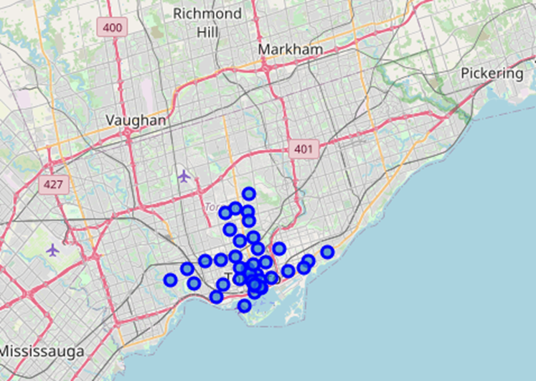
Exploratory Data Analysis (1)
Visualization of the neighborhoods in Toronto: map out the geographical visualization of the neighborhoods in Toronto for further in-depth analysis

Slide 5
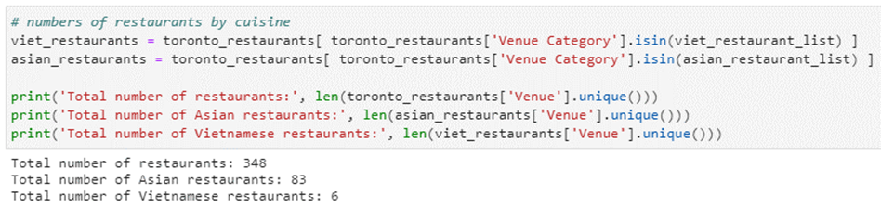
Exploratory Data Analysis (2)
Filtering venue data to focus on restaurants, Asian restaurants and Vietnamese restaurants:
There are in total 348 venues classified as restaurants, in which, 83 (24%) are Asian restaurants, and 6 (1.7%) are Vietnamese restaurants. There are 35 neighborhoods that do not currently have any Vietnamese restaurants

Slide 6
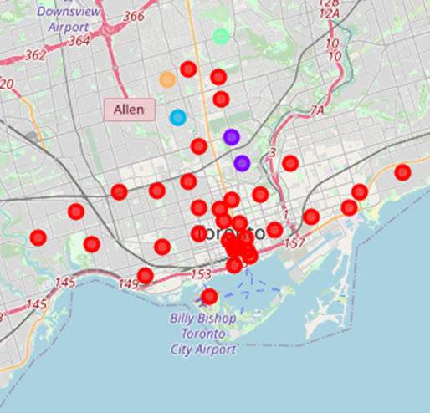
In-depth Analysis – Results (1)
Clustering the neighborhoods in Toronto by venues using k-means clustering
Most of the venues are clustered in one single big cluster (Red - called Cluster 1)
Cluster 1-Red: contains restaurants, cafes and eateries.
The cluster shows that restaurants, cafes and bar are distributed evenly and widespread across all the neighborhoods of Toronto
Too vague to make a decision, we need a more zoomed in result and more specific factor for the best decision

Slide 7
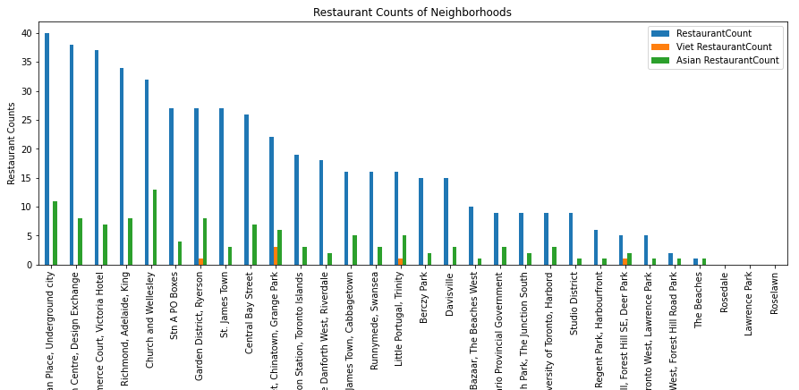
In-depth Analysis – Results (2)
Segmentation and visualization of the restaurants distribution in each neighborhood by cuisines

Slide 8
Discussion
The clustering of venues by neighborhood shows that restaurants and cafes are evenly spread throughout all the neighborhoods of Toronto, except The Beaches, Roselawn and the Parks.
Not enough to just use this clustering to conclude which neighborhood is the most potential to open a new Vietnamese restaurant.
It is necessary to segregate and visualize the distribution of all restaurants in each neighborhood by cuisine
Create a clearer picture on where the indirect competitors (other Asian restaurants) and the direct competitors (other Vietnamese restaurants) are situated

Slide 9
Conclusion
Choosing neighborhoods with a high number of restaurants are potential to have high diner traffic .
If the said neighborhoods do not have many existing Asian/Vietnamese restaurants, the possibility for a Vietnamese restaurant to be chosen would be higher
Stn A PO Boxes; St. James Town; Commerce Court, Victoria Hotel

